Slide 1
Starting your project
COMP5200M
Language Centre In-sessional, School of Computer Science
Dr Denise de Pauw
d.b.depauw@leeds.ac.uk

Slide 2
Session aims
Introduce Language Centre in-sessional tuition
Discuss research & writing process
Think about how to ensure academic integrity and good time management
Working with the timeline, templates & assessment criteria

Slide 3
Language Centre insessional support on
COMP5200M
MSc process flowchart 22-23
5 weekly sessions from week 16-24
Sessions designed to support upcoming tasks
Drop-ins over Easter teaching break
Bookable 1:1/small group workshops for any questions (or email me for a tutorial)

Slide 4
Week | topic | Link to key task
16 | Starting your project Talking about your interests; choice of supervisor Process of writing & milestones | Choosing a supervisor
17 | Communicating with your supervisor Expectations about supervision; how to write an email; email writing practice | Write introductory email to supervisor
18 | Writing a project specification form Writing about aims, objectives and deliverables in an interim report. | PSF
22 | Literature reviews: structure, purpose, scope, establishing the research gap; academic integrity & use of sources | Scoping and planning document
24 | Academic writing: structuring a report; sections; paragraphing; coherence and cohesion | Writing chapters

Slide 5
Your interests
Talk to somebody else
What are your research interests?
What supervisors have you chosen?
What are their specialisms?
How are their specialisms related to your interests?
This small talk can help you begin to develop your rationale for the project

Slide 6
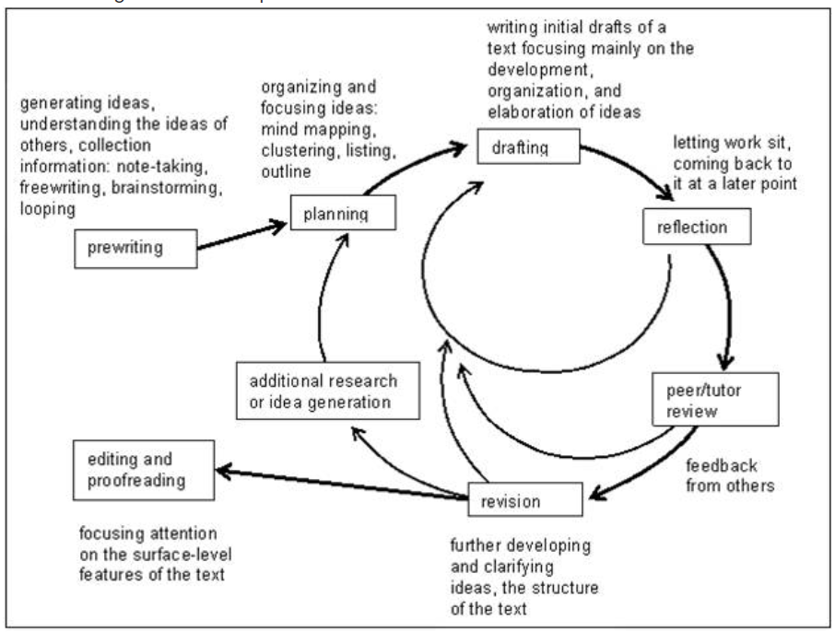
Writing as a process
What are the steps to writing your research project report? (e.g. searching the library for information, selecting sources, etc)
What order would you do them in?
When will you start writing?
What different types of writing will you be doing? (e.g. annotations, notes on reading, memos, draft chapters etc)
Image from https://library.defiance.edu/writingprocess/writingprocess

Slide 7
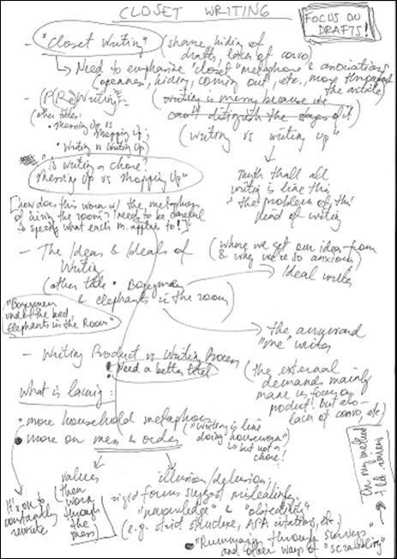
Tips for writing barriers
Write from day 1- tiny texts are very powerful
Talk to others about work in progress
Draw pictures, mindmaps
Write as you go- notes, memos, questions to self
These will be the building blocks for your first draft chapters
Draft sections in stages
Take breaks between drafting and editing
Image from Trofimova, Evija. (2017). Closet Writing. 21. 10.52086/001c.25291.

Slide 8


Organise as you go
This Photo by Unknown author is licensed under CC BY-NC-ND.

Slide 9
Academic integrity and good time management
Be organised
Keep notes organised- e.g. in folders/OneNote or similar app
Write them bi-lingual or English, to make drafting chapters easier later
Use a note-making template, e.g. Cornell
Keep bibliographic record of all sources, at top of note page or in file name
Which of the above do you do?
Helpful for:
academic integrity
time management
stress management
making progress visible to you and supervisor

Slide 10
Working with templates and assessment criteria
Templates provide overall structure
Use them as checklists for layout and general kind and sequence of content
Look at samples of past work, to see how others have used the templates (on Minerva or Library website)
Assessment criteria- use to evaluate own work in progress
In our sessions, we'll be methodically working through how to approach the writing of each template, starting with the project specification
Look on Minerva now, for the templates you'll need.
Can you find the report marking criteria?

Slide 11
Any questions, suggestions?
Session resources>Minerva>Language Centre in-sessional folder
Includes list of additional self-study resources
Additional social speaking practice (in any language) - The Language Zone, Parkinson Building, level 2 or online on Minerva/Teams
https://minerva.leeds.ac.uk/webapps/blackboard/content/listContent.jsp?course_id=_513108_1&content_id=_7159622_1&mode=reset

